Slide 1
SKKU Parking Guide
Real-Time Parking App
Weekly Progress
Team I-dle Kim Seheon Kim Hyeongjin Noh Hayeon Park Inchan

Slide 2
Contents
Project Overview
Weekly Progress
Color based detection / Testing / Challenges
Future Plan
Next steps for project advancement
Team Contributions

Slide 3
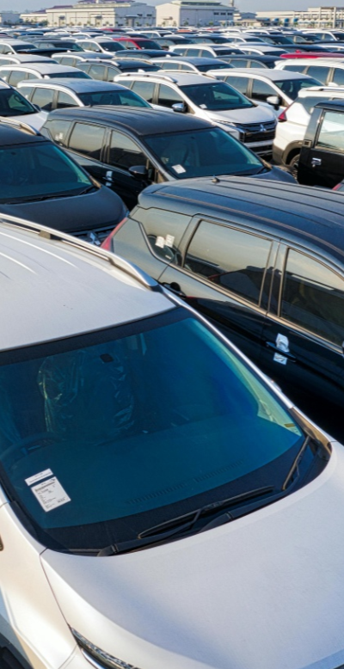
Project Overview
#1
Parking management system uses
to detect car park vacancies
Technical Background
1. YOLOv5:
real-time analysis of parking spaces and vehicle sizes.
2. Camera and AI integration system:
Data collected by cameras is processed by AI model, stored in a database, and linked to a mobile app.

Slide 4
Weekly Progress
#2
~Week12 | Week13 | Week14~
Color based detection
Testing
Revision

Slide 5
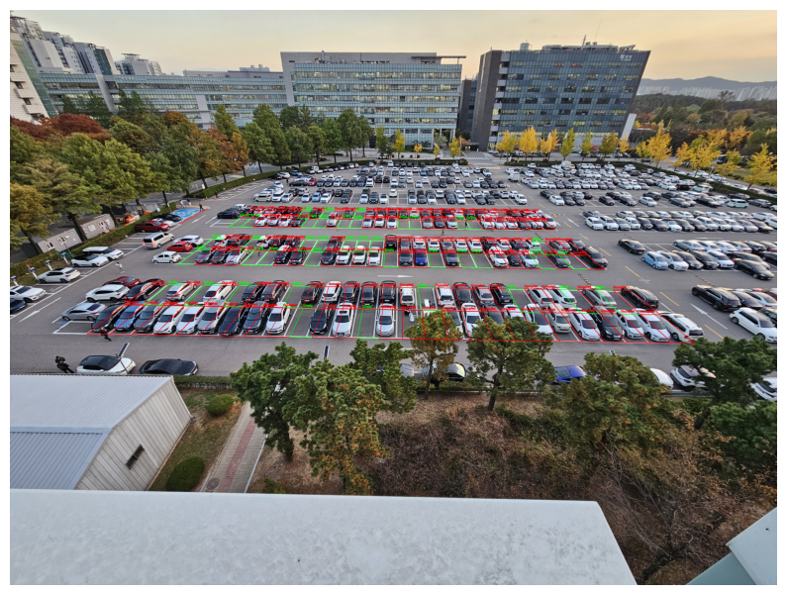
Color based detection
#2.1
If the gray (asphalt color) ratio of each parking space exceeds 35%, it is treated as empty.
In this view, the accuracy was high enough to be found accurately except for three slots.

Slide 6
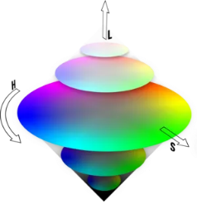
Color based detection
#2.1
HSV representation :
Hue, Saturation, Value(Brightness)
Brightness adjustment -> it can be identified even if the brightness changes.

Slide 7

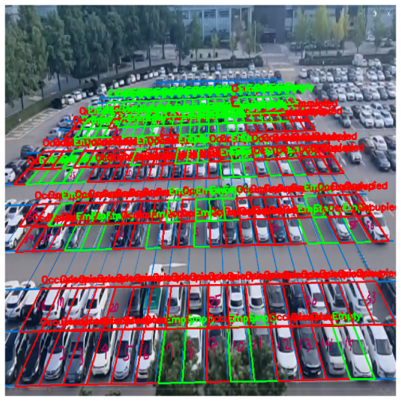
Model Improvement
#2.2
+
Accuracy for
Allocated space : 96%
e
Color based detection
Yolov5 detection custom data

Slide 8
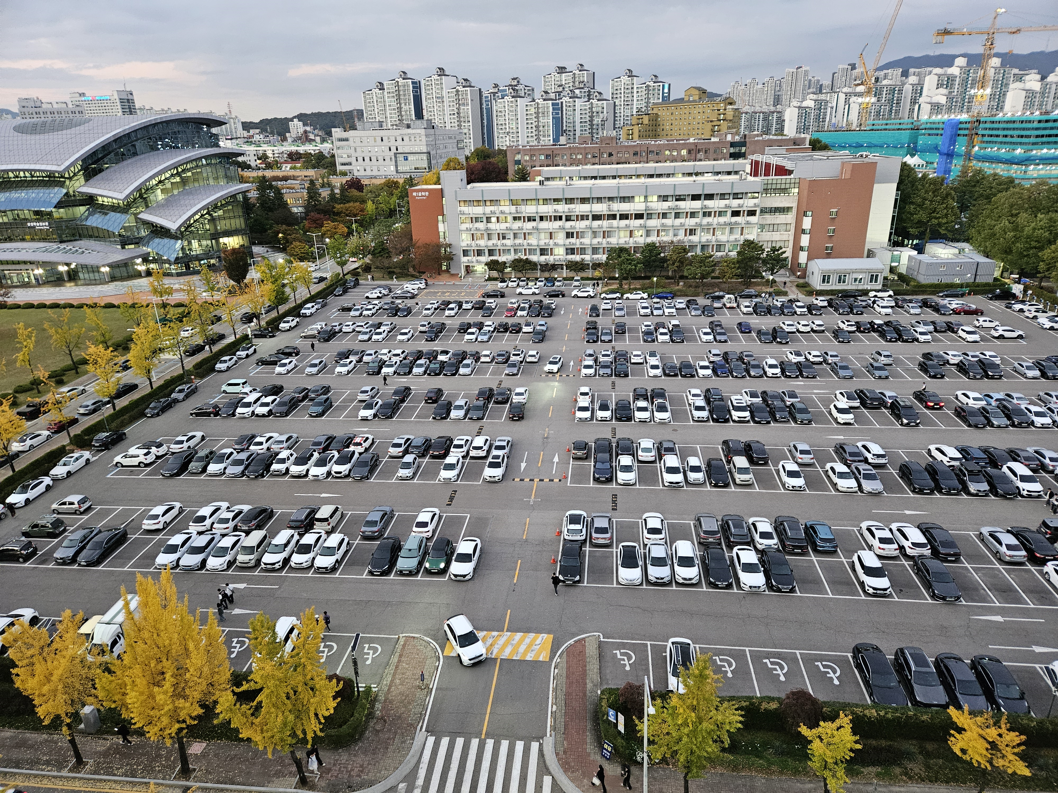
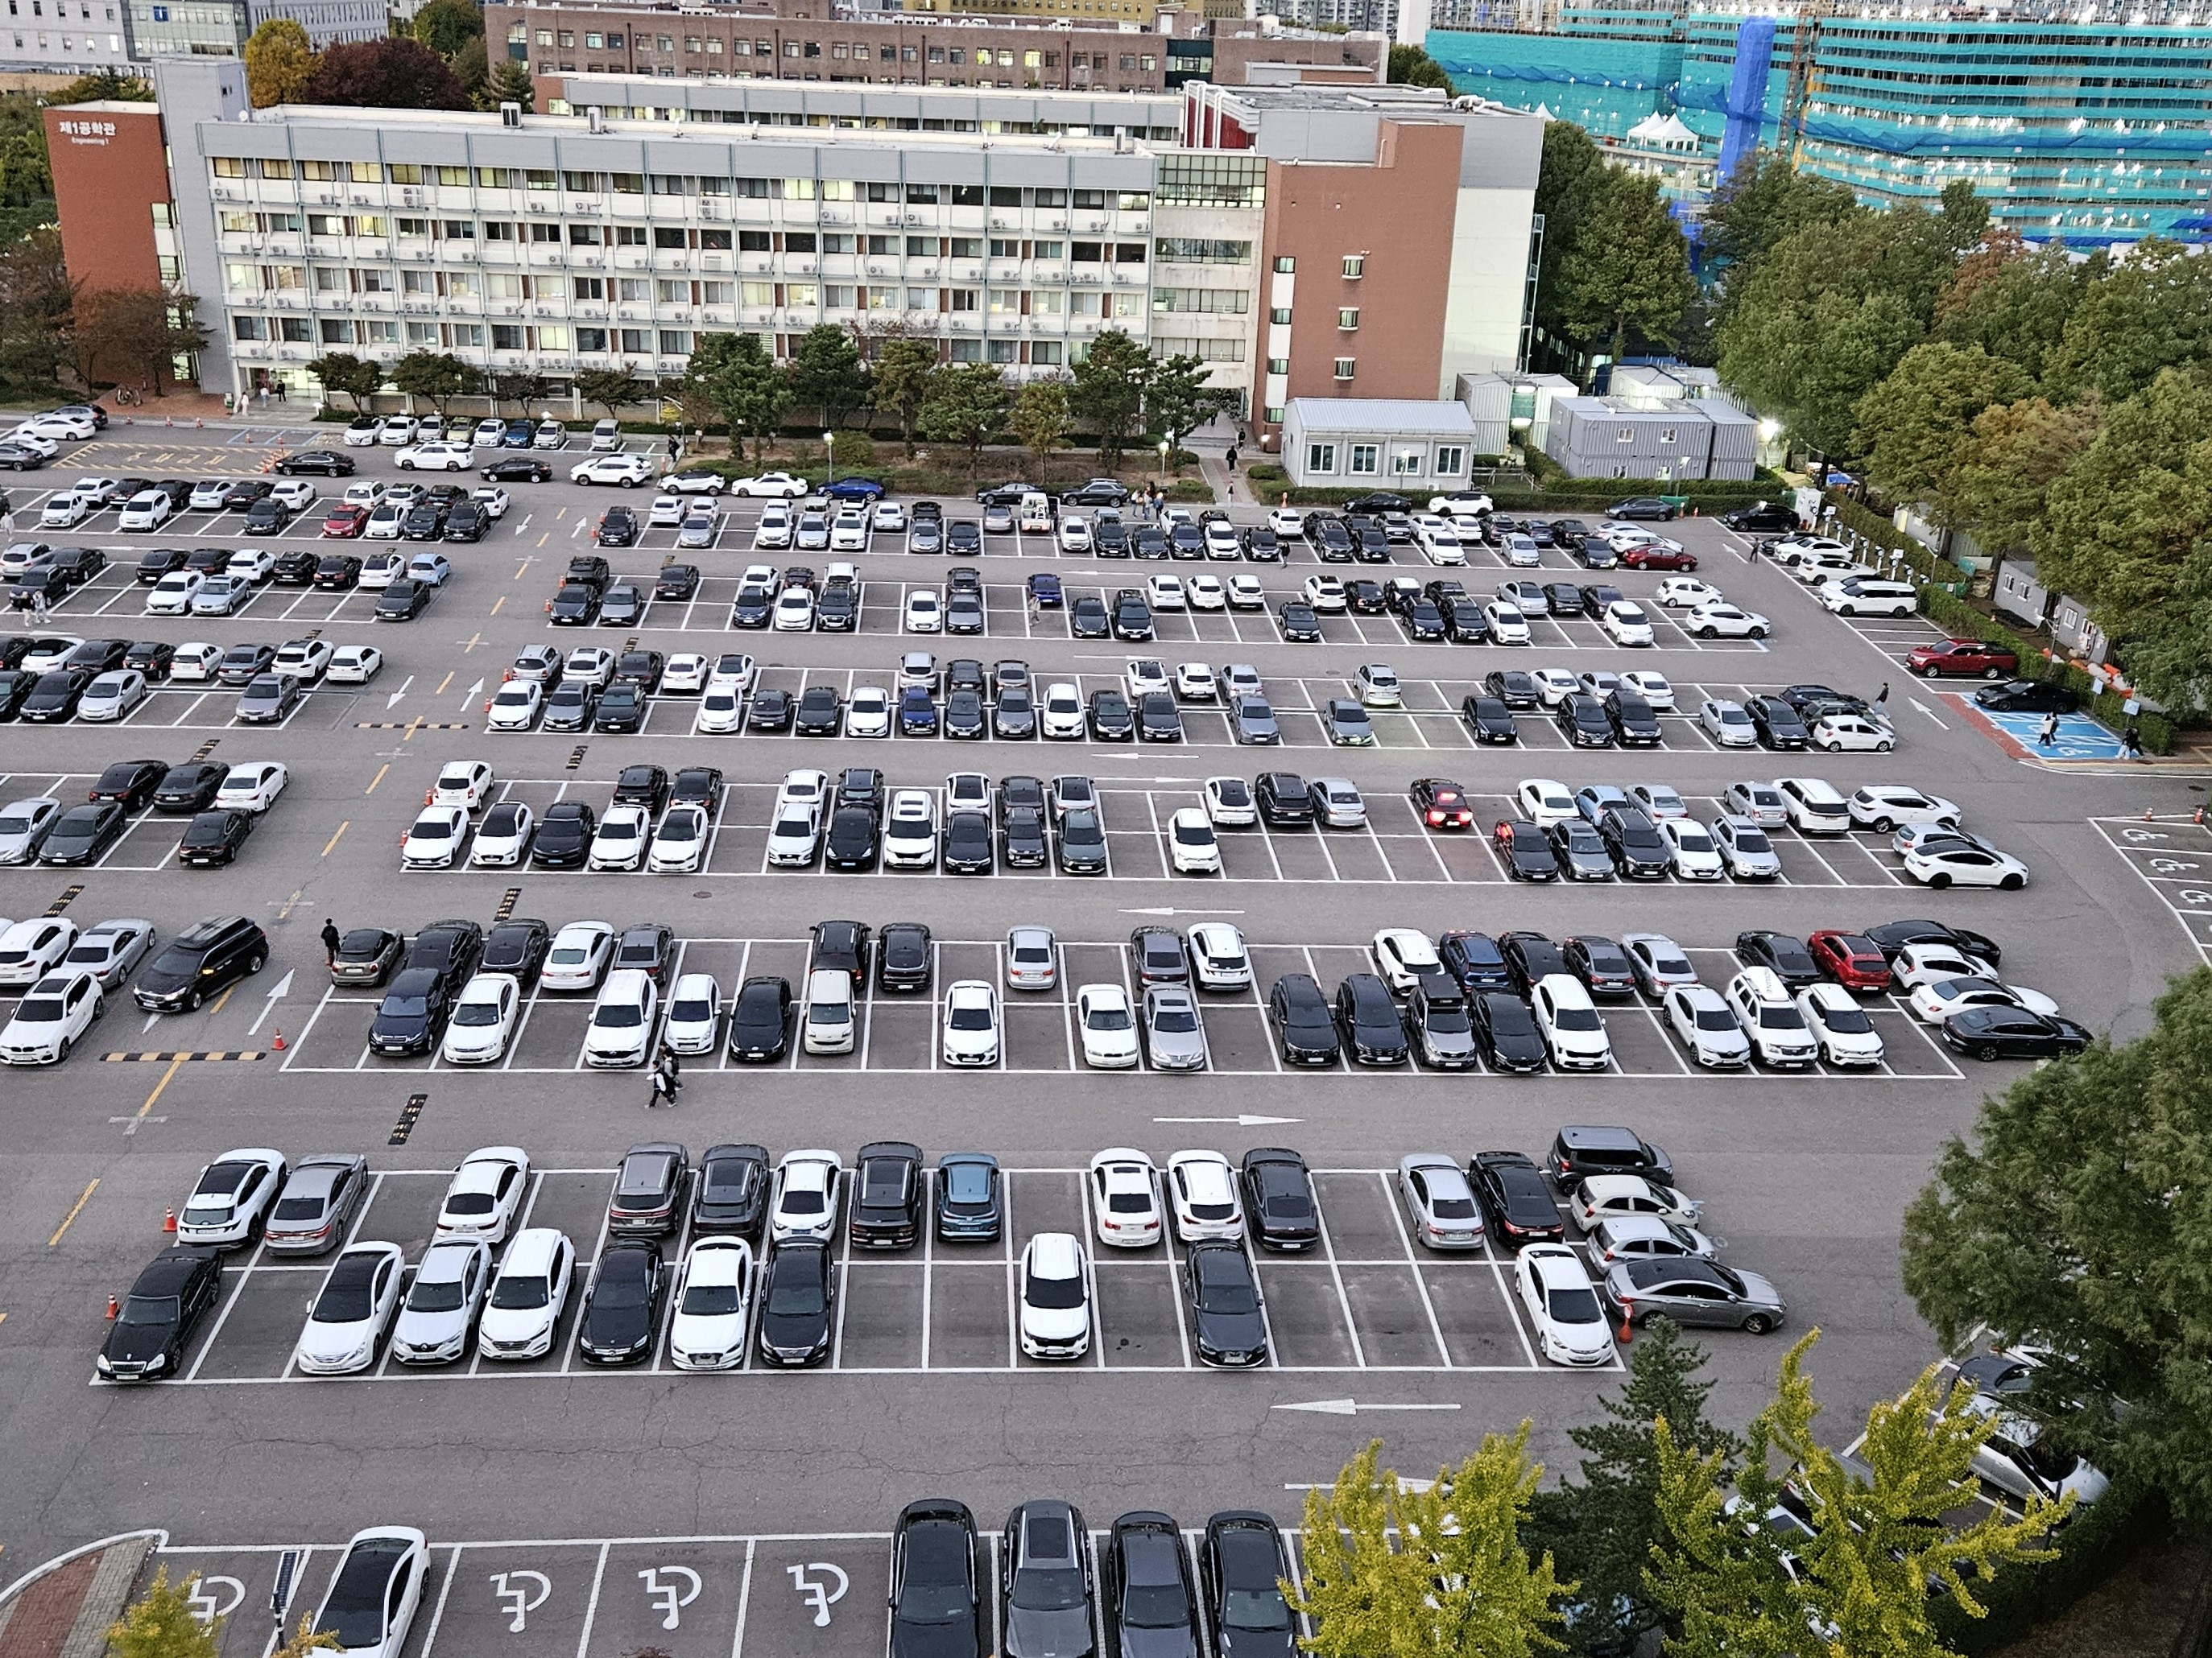
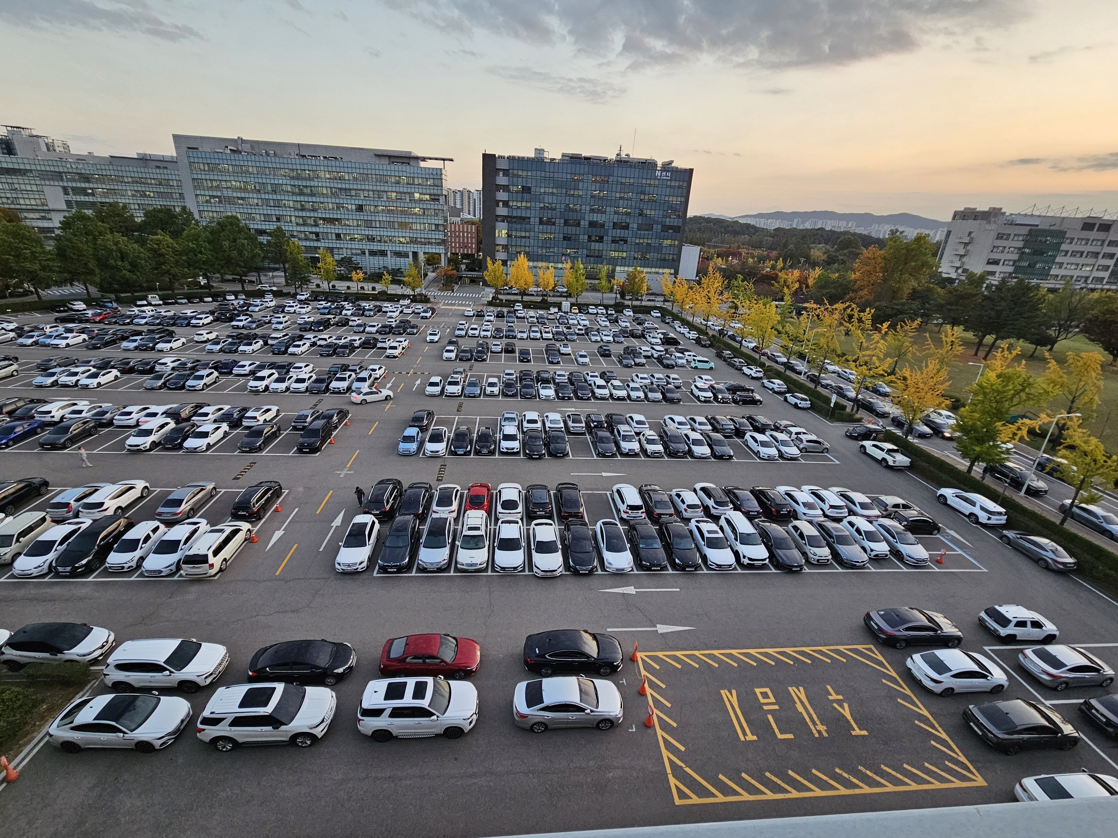
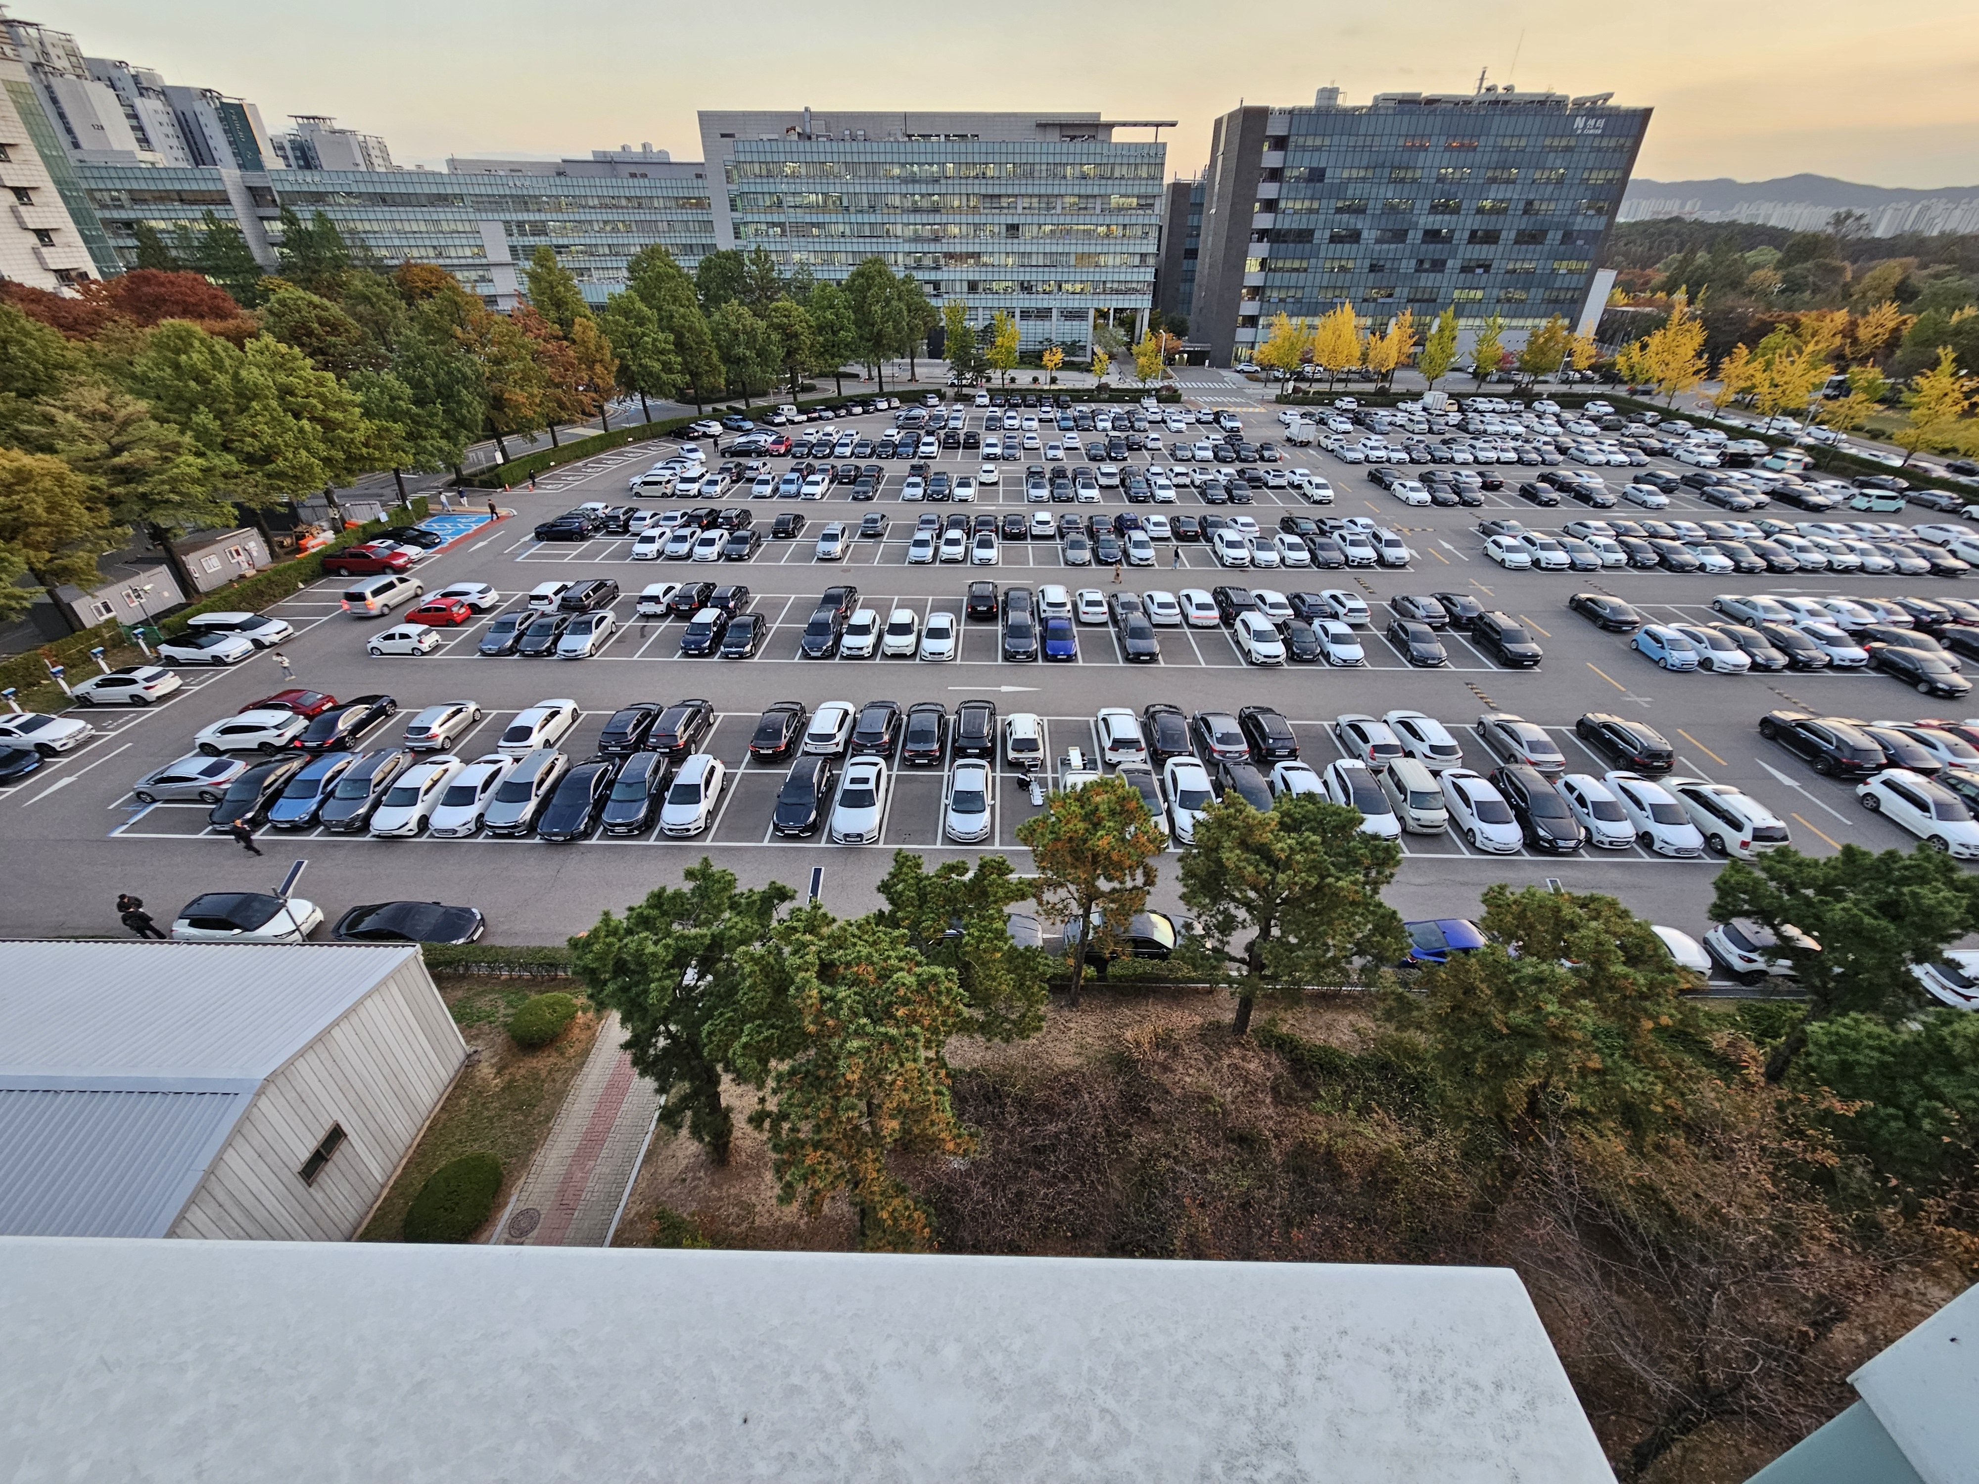
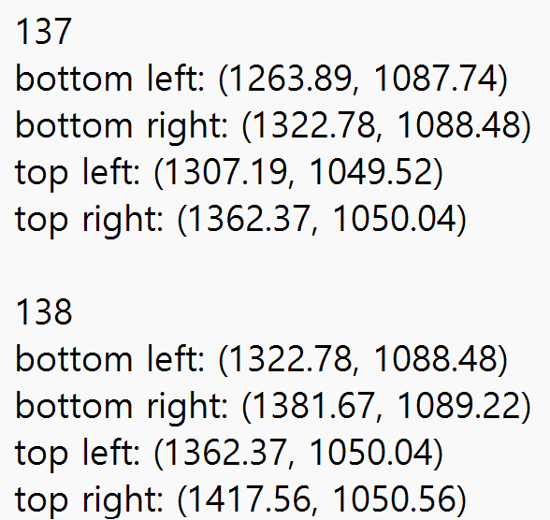
Testing plan
#2.3
Pharmaceutical
View A
Pharmaceutical
View B
Engineering
View A
Engineering
View B
coordinate extraction

Slide 9
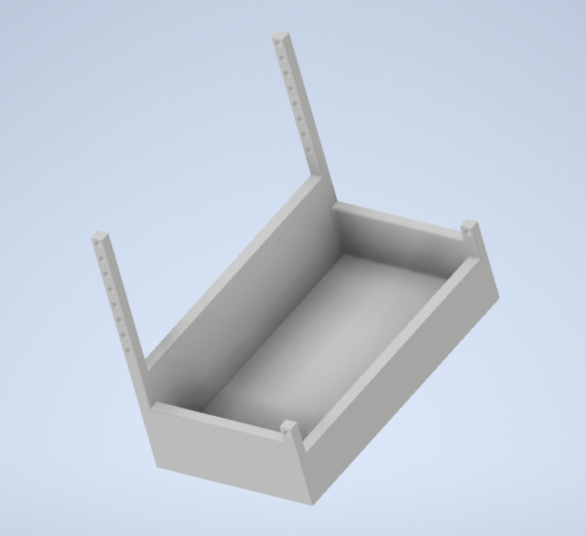
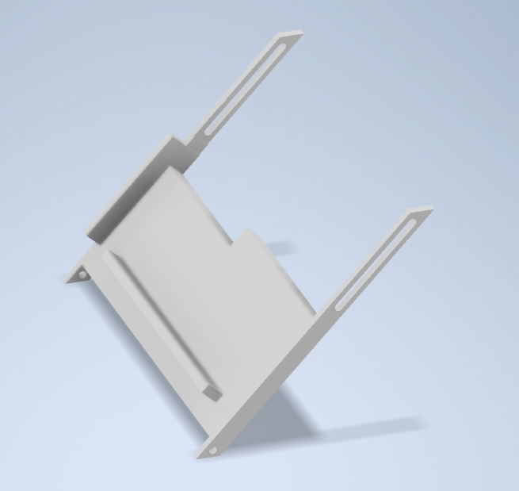
Camer system hardware design
#2.3
Designed to allow flexible angle adjustment considering the size of the camera, and securely fixed to ensure the system remains table against external environment

Slide 10
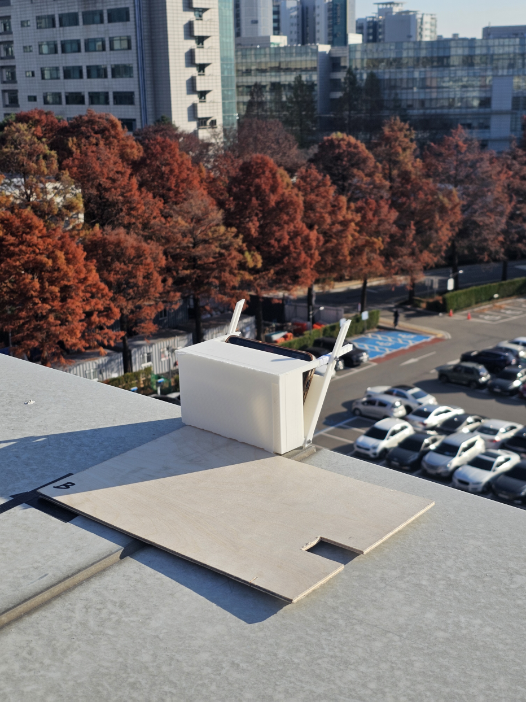
Breif Test
#2.3
The camera holder was manufactured with a 3D printer.
And test at the Engineering Building
Main test plan was 11.28 but..

Slide 11
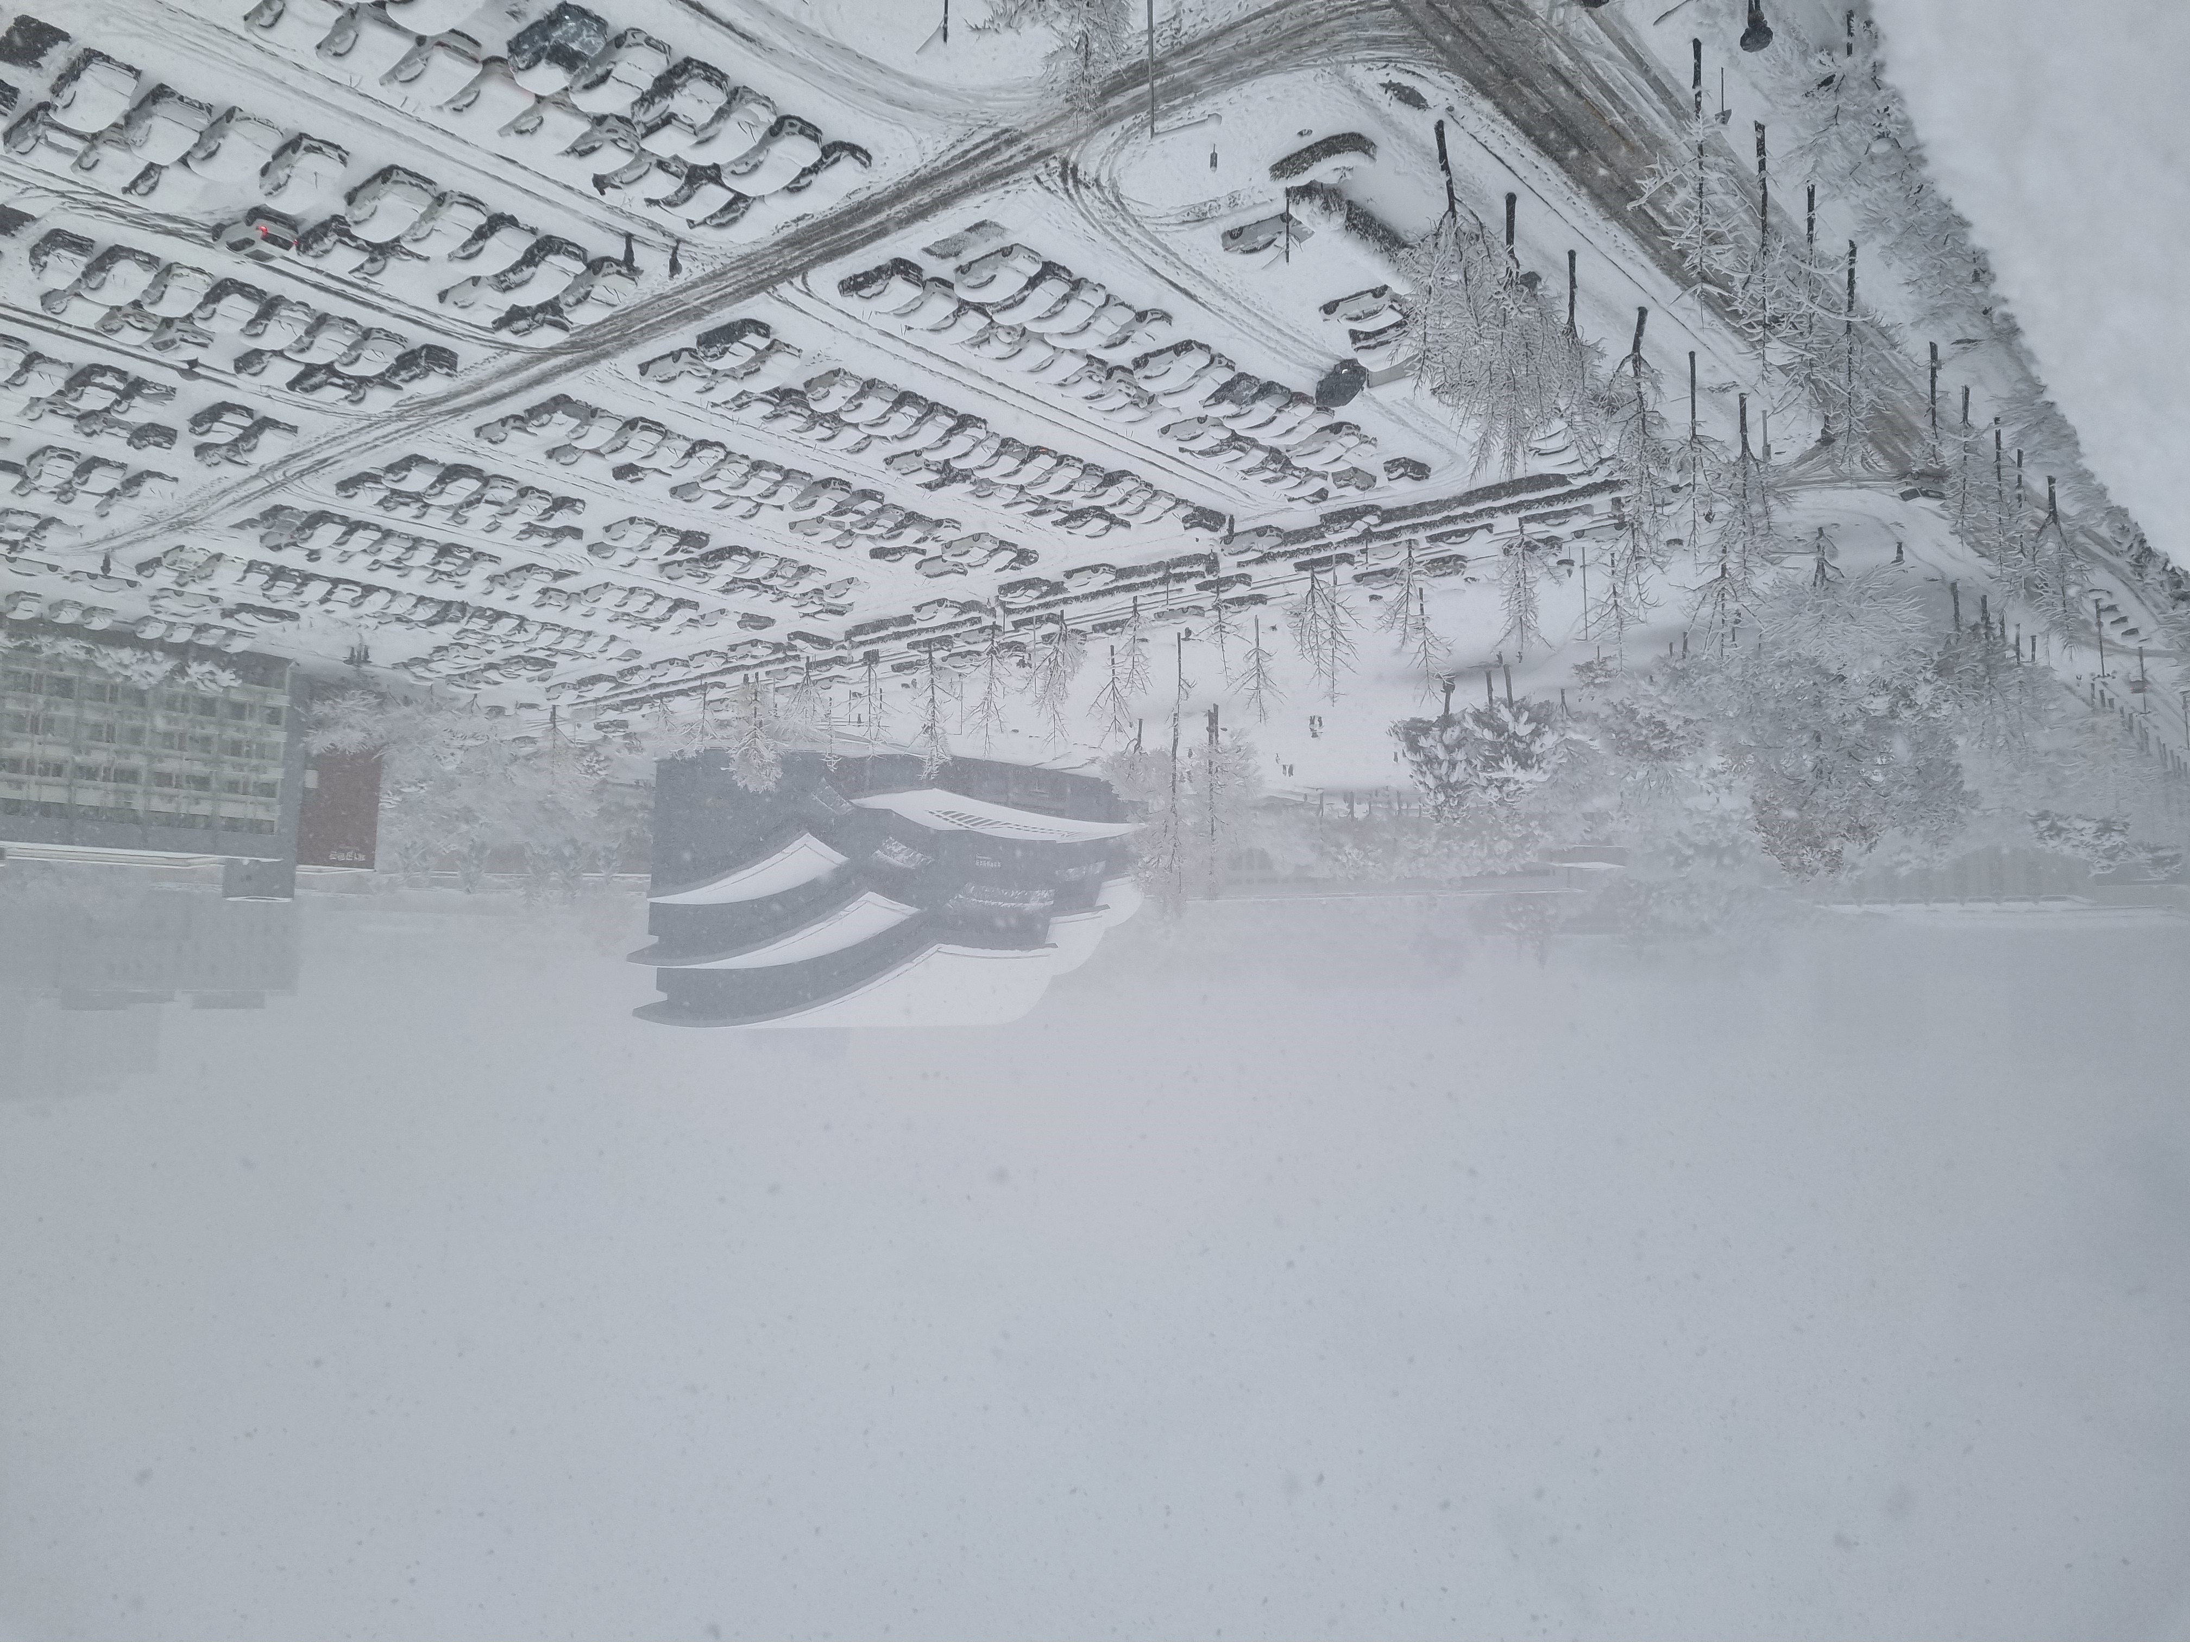
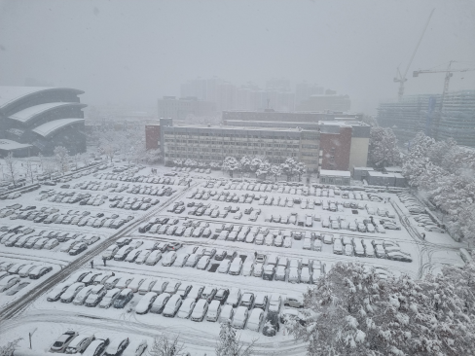
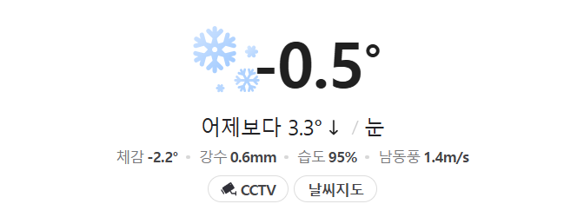

Challenge
#2.4
Due to huge snow, the main test schedule has been postponed to next week
알 수 없는 작성자 님의 이 사진에는 CC BY-NC 라이선스가 적용됩니다.

Slide 12
Future Plan
#3
Testing & Revision
00.

Slide 13
Team Contributions
Kim Seheon
Kim Hyeongjin
Noh Hayeon
#4
Park Inchan
Team Leader
Front-end
Development
System Integration
Testing AI model
Model refinement

Slide 14
Thank You

